Slide 1
Stability FEA modelling - Silverado2 BTE13 F4 RDL/GR and F3 RDL with/without Frame Open
Yu Luan
July 31st, 2017

Slide 2
Abstract
Silverado 2 BTE13 F4 RDL, F4 GR, F3 RDL and F3 RDL with Frame Open form factors are modelled in Abaqus for stability
Results are compared together with Berlin70 (hard mounted RDL) for reference

Slide 3
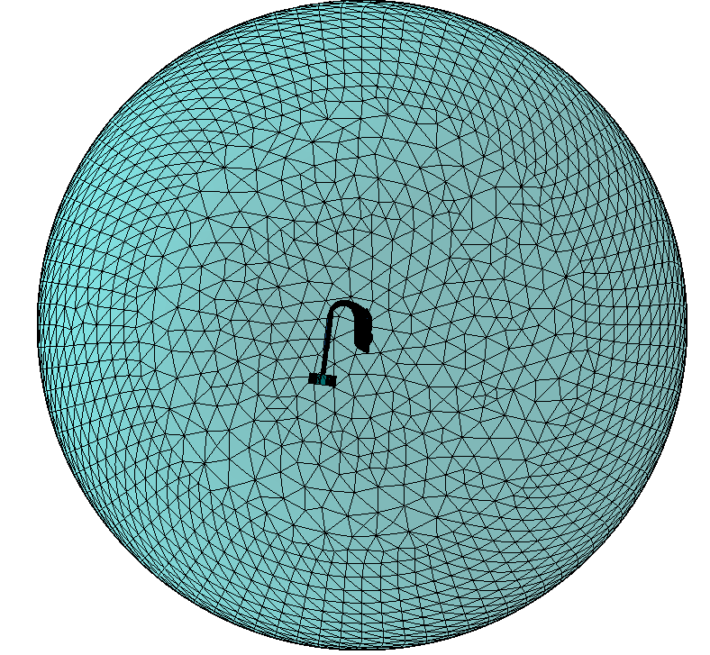
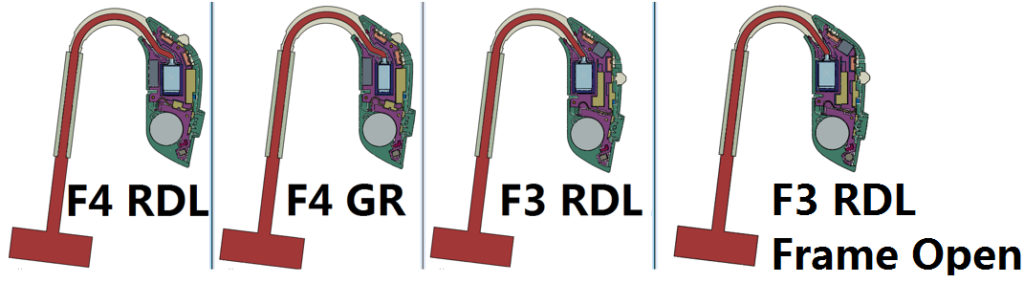
Abaqus stability models of F4 RDL/GR, F3 RDL
F4 RDL, F4 GR, F3 RDL and F3 RDL Frame Open stability models have been made in Abaqus. The components’ geometry are simplified for simulation purpose. The contacts between components are solid. Receiver vibration and acoustic output are applied in the model; the sound pressure at microphones’ membrane, and the microphones’ housing vibration are obtained.

Slide 4
Simulated MSG comparison
The obtained sound pressure at microphones are combined with microphones’ housing vibration to give the equivalent SPL at mic.
The MSG is calculated by subtracting mic. equivalent SPL from coupler pressure.
The obtained MSG of all 3 form factors are not worse than Berlin70 hard mounted RDL. It indicates that they can all pass the stability test.

Slide 5
Simulated MSG comparison
All form factors are not worse than the reference, Berlin70 with RLD hard mounted.
F3 RDL and F4 GR give equally the best MSG, but the GR is rotated, which makes the HI fatter.
F4 RDL gives MSG 1-3dB worse than the mentioned two good ones.
F3 RDL with Frame Open gives MSG 1-4dB worse than the mentioned two.

Slide 6
Summarization
Silverado 2 BTE13 F4 RDL, F4 GR, F3 RDL and F3 RDL with Frame Open stability models showed MSG not worse than Berlin70 with RDL hard mounted, which has passed the stability test. According to this, all of the mentioned form factors can pass the stability test.
F3 RDL and F4 GR give equally the best MSG, but the GR is rotated, which makes the HI fatter.

Slide 7
Appendix 1 – Berlin70 hard mounted RDL MSG (Abaqus vs Measurement)

Slide 8
Appendix 2 – Simulated coupler pressure

